Slide 1
Planning and Organizing
For
Advik Hi-Tech Pvt Ltd
Facilitator
Mr. Amol Dagwade

Slide 2
What is Planning?
Planning involves:
Defining goals
Developing strategies and plans for achieving these goals

Slide 3
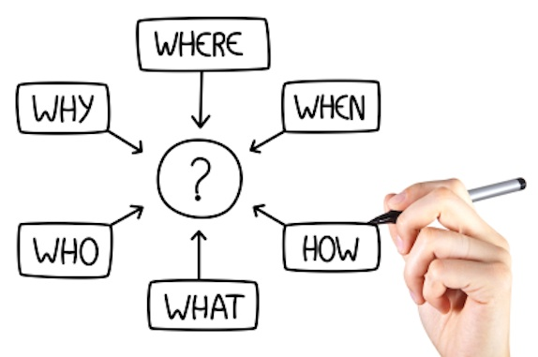
Key components of Planning

Slide 4
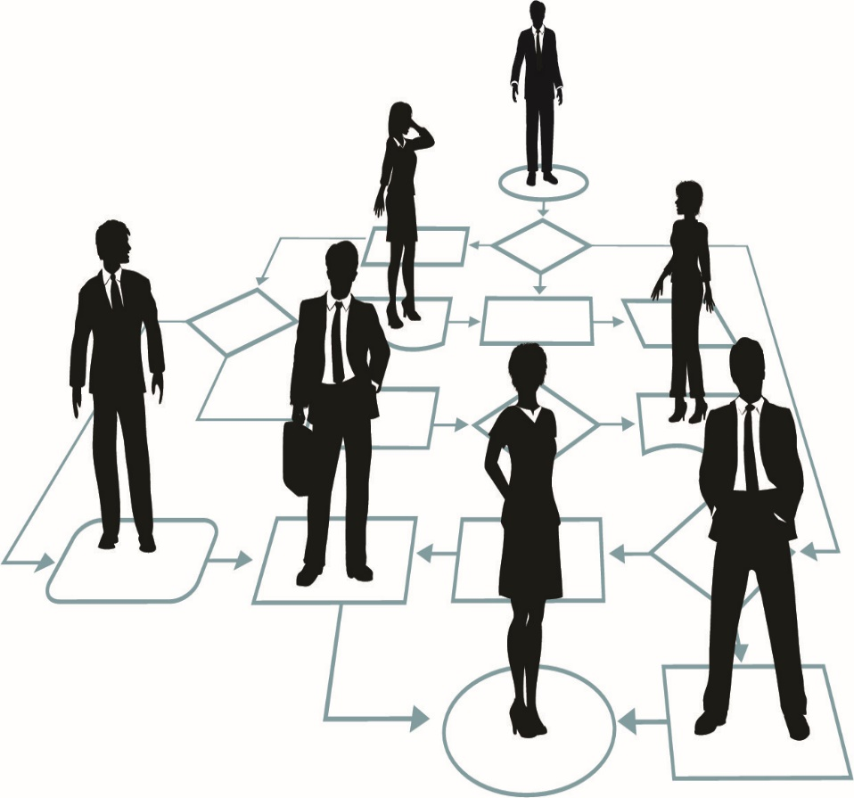
What is Organizing?
Organizing means:
Orderly and logically classify work activities towards objectives.
Effectively assign people to achieve work or given objectives.
It involves the process by which responsibilities are distributed in such a way that everyone knows “who does what”

Slide 5
Organizing Involves Determining :
What tasks are to be done?
Who is to do them?
How the tasks are to be grouped?
Who reports to whom?
Where decisions are to be made?

Slide 6
Integrated Vision
Business
Thinking/ Long Term
Time Spent ?
%
- Unknown zone
Inspiration driven
- Transformational Growth
Risk
Complexity
Ambiguity
Innovation
Challenges
Close the possibility gap
Thinking level
Hidden KASH
Functional
Isolated Vision
Time Spent?
%
Working / short term
Close the performance gap
Working Level
- Known zone
Motivation driven
Driven by JD, KRA, goals, objectives, SOP’s
Developed KASH
Personal
Tunnel Vision
Learning Level
Developing KASH

Slide 7
Why Planning & organizing is Important?
Efficient use of resources
Establishing and achieving set goals
Managing risk and uncertainty
Effectively deal with challenges and change
Team building
Creating competitive advantages

Slide 8
Business Planning Process
Vision
Performance Score Cards
Activities/Projects
Strategic Objectives
Mission
Strategic Goals

Slide 9
6 Rules to be Effective in Planning and Organizing
Effective Planning & Organizing
Prioritizing
Time Management
Team Work
Delegation
Systems
Planning Ahead

Slide 10
Prioritizing – Urgent vs. Important
Urgent Not Urgent
Important
Not
Important
I
Crisis
Deadlines
Meetings
Conflicts
Generic Mails
II
Planning
Clarifying Values
Building Relationships
Skill Development
III
Phone Calls
Interruptions
Generic Mails
IV
Junk Mail
Surfing the Internet
Social Media
Games

Slide 11
The Pareto principle (also known as the 80–20 rule) states that, for many events, roughly 80% of the Effects come from 20% of the Causes.
Examples:
80% of your sales are made by 20% of your sales staff
20% of the staff will cause 80% of the problem.
20% of staff activities produce 80% results
80% of your profits come from 20% of your customers
80% of your complaints come from 20% of your customers

Slide 12
Parkinson’s Law
'Work expands
so as to fill the time available for its completion.‘
Which means that if you have an assignment due to next week, the assignment will only be finished next week. But if you're given 2 months' time for the same assignment, then the assignment will take 2 months to complete.

Slide 13
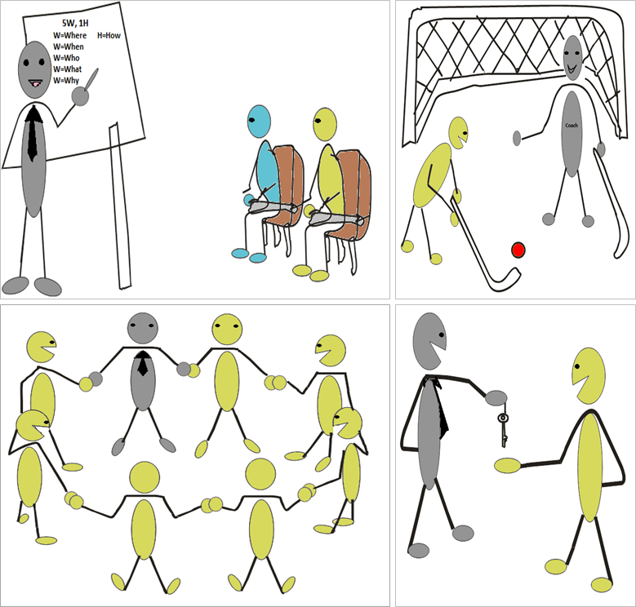
Situational Leadership

Slide 14
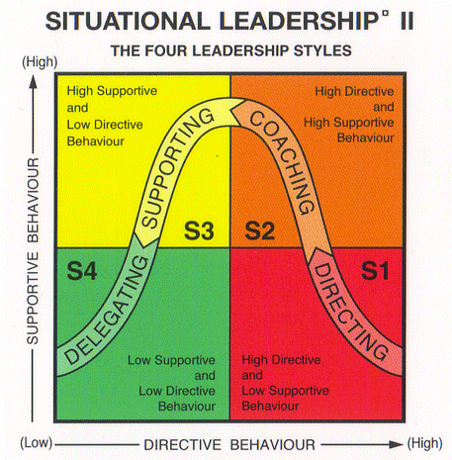

Slide 15
D3
Moderate to High Competence
Variable Commitment
D2
Low to Some Competence
Low Commitment
D4
High Competence
High Commitment
D1
Low Competence
High Commitment

Slide 16
Situational leadership style requirements
Insight: The situational leader must be able to understand the needs of the followers, then adjust his or her management style to meet those needs
Flexibility: Situational leaders must be able to move seamlessly from one type of leadership style to another
Trust: The leader must be able to gain his or her followers’ trust and confidence
Problem solving: The situational leader must be able to solve problems, such as how to get a job done using the best leadership style available
Coach: The situational leader must be able to evaluate the maturity and competence of the followers and then apply the right strategy to enhance the follower’s competency

Slide 17
What are Systems?
A set of detailed methods, procedures and routines created to carry out a specific activity, perform a duty, or solve a problem.

Slide 18
Examples of Systems
Diary
Schedule
Email management
Checklists

Slide 19
Benefits of Creating Systems
Accountability and Responsibility
Improved Employee’s Performance
Continuous Quality Results
Customer Satisfaction
Increased Profitability

